Slide 1
Snowflake – Data Sharing
Secure Data Sharing
Shares are named Snowflake objects that encapsulate all of the information required to share a database
No Data transfer happens, or no new data is created
Snowflake data sharing happens through SF Metadata Layers and Global Services Layer
Providers : A data provider is any Snowflake account that creates shares and makes them available to other Snowflake accounts to consume
Consumers : A data consumer is any account that chooses to create a database from a share made available by a data provider
Reader Account: Share data with a consumer who does not already have a Snowflake account and/or is not ready to become a licensed Snowflake customer.

Slide 2
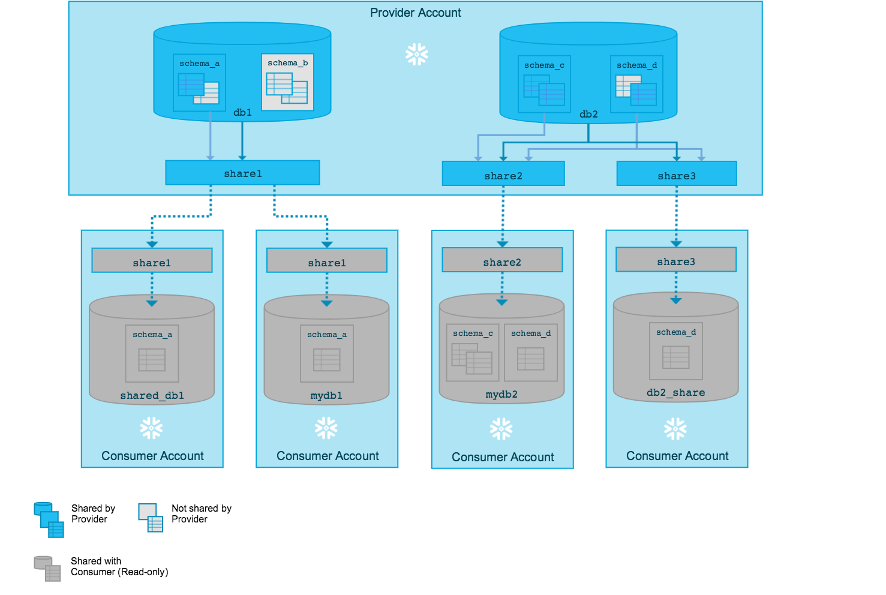
Snowflake – Data Sharing
Secure Data Sharing

Slide 3
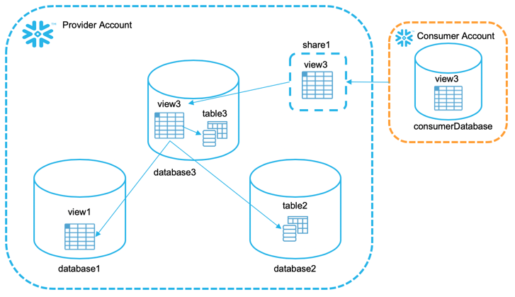
Snowflake – Data Sharing
Share
Create a Share
Add Objects to Share
Add Accounts to Share
Providers
Consumers
Sharing Data From Multiple Databases

Slide 4
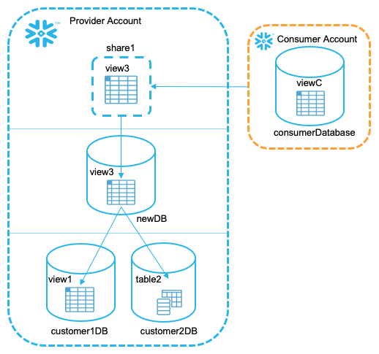
Snowflake – Data Sharing
Sharing Data From Multiple Databases

Slide 5
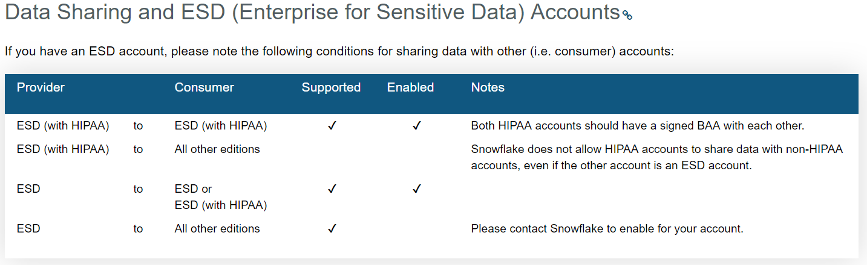
Snowflake – Data Sharing
Sharing Data Enterprise Editions
Do not share sensitive data with non-ESD accounts.
Consider creating a second, non-ESD account where you store less sensitive data and share this data with non-ESD accounts.
If you are using Tri-Secret Secure with your ESD account and you share data with other accounts, Snowflake treats the data access from these accounts as if the access occurred from within your own account. Specifically, granting access to the consumer account may require Snowflake to access your AWS KMS.

Slide 6
Snowflake – Data Sharing
Sharing Data
Web UI – Inbound , Outbound
Outbound Shares (Providers)
Shares that you have created and you have access to
Create a Share
Edit Shares
Inbound Shares (Consumers)
View Shares from providers that you are granted to
Create a Database for the share
Sharing Considerations
Currently, consumer accounts must be in the same Snowflake Region as your account; i.e. you can only share with other accounts in your Snowflake Region.
A share can include data from multiple databases.
For data security and privacy reasons, only secure views are supported in shares at this time. If a standard view is added to a share, Snowflake returns an error.
Adding accounts to a share immediately makes the share available to consume by the accounts.
New and modified rows in tables in a share (or in tables referenced by a view in a share) are available immediately to all consumers who have created a database from the share. Keep this in mind when updating these tables.
A new object created in a database in a share is not automatically available to consumers.

Slide 7
Snowflake – Data Sharing
Share DDLs
Create Share
Alter Share
Drop Share
Describe Share
Show Shares
Grant <Privileges> to Share
Revoke <Privileges> to Share
Show Grants to Share
Show Grants of Share
alter session set simulated_data_sharing_consumer='gt54793’;
Adding Accounts to a Share
alter share sales_s add accounts=xy12345, yz23456;
Removing Accounts From a Share
Alter share sales_s remove accounts=xy12345;
Dropping Share
Drop share sales_s;

Slide 8
Snowflake – Data Sharing
Consumers
AccountAdmin role to Import Shares
Any Account with IMPORT SHARES global Privilege can import Shares
General Limitations for Shared Databases
Shared databases are read-only. Users in a consumer account can view/query data, but cannot insert or update data, or create any objects in the database.
The following actions are not supported:
Creating a clone of a shared database or any schemas/tables in the database.
Time Travel for a shared database or any schemas/tables in the database.
Editing the comments for a shared database.
Viewing Available Shares
Web Interface : Click On shares – Inbound
SQL : Show Shares or desc Shares
Creating a Database from a Share
Web Interface : Click On Shares – In bound
Select the Share
Create Database From Share
create database snow_sales from share xy12345.sales_s;

Slide 9
Snowflake – Data Sharing
Reader Accounts
Reader accounts (formerly known as “read-only accounts”) enable providers to share data with consumers who are not already Snowflake customers, without requiring the consumers to become Snowflake customers.
ACCOUNTADMIN Role only handles Reader Accounts
A reader account enables data consumers to access and query data shared by the provider of the account, with no setup or usage costs for the consumer, and no requirements for the consumer to sign a licensing agreement with Snowflake
The reader account is created, owned, and managed by the provider account
Reader Account is responsible for all credit charges incurred by users in reader account

Slide 10
Snowflake – Data Sharing
What is Restricted/Allowed in a Reader Account
A reader account is intended primarily for querying data shared by the provider of the account.
Below commands are not allowed in Reader Account
INSERT
UPDATE
DELETE
MERGE
COPY INTO <table>
CREATE PIPE
CREATE SHARE

Slide 11
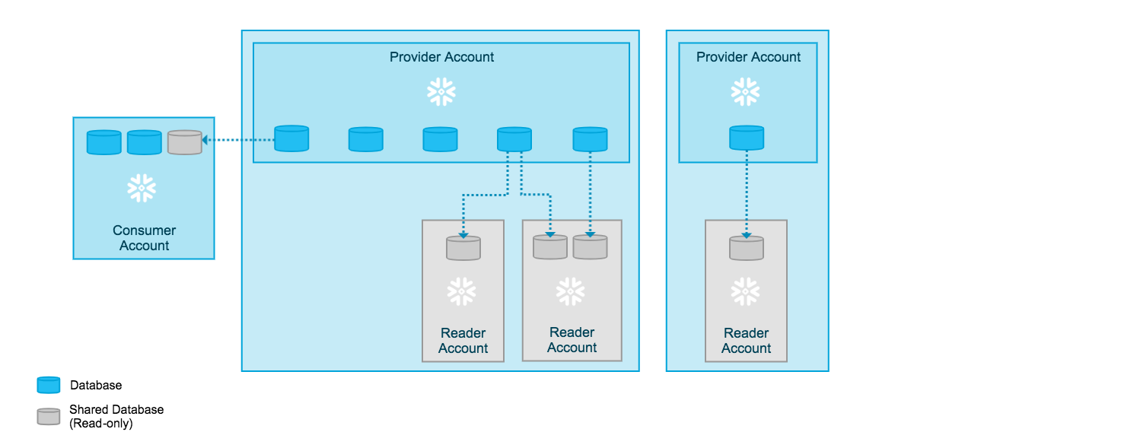
Snowflake – Data Sharing
Reader Accounts

Slide 12
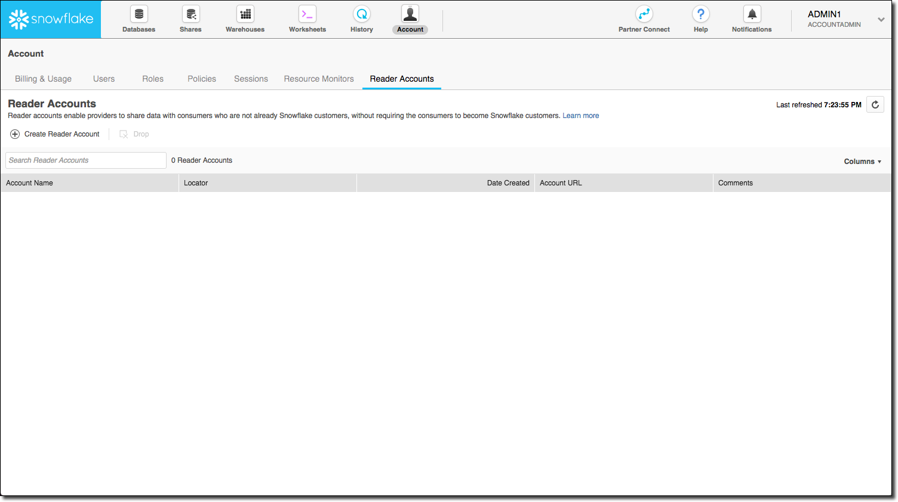
Snowflake – Data Sharing
Creating Reader Accounts
ACCOUNTADMIN role (or having a role that has been granted the CREATE ACCOUNT privilege)

Slide 13
Snowflake – Data Sharing
Enabling Other Roles to Create and Manage Reader Accounts
use role accountadmin;
grant create account on account to role sysadmin;
Creating and Managing Reader Accounts Using SQL
use role accountadmin;
create managed account reader_acct1
admin_name = user1 , admin_password =‘xyz123' ,
type = reader;
Dropping a Reader Account
use role accountadmin;
drop managed account reader_acct1;

Slide 14
Snowflake – Data Sharing
Configuring Reader Account
Task 1: Log into the Reader Account as the Account Administrator
Task 2: Create Custom Roles (Optional)
Task 3: Create Users
Task 4: Create Resource Monitors (Optional)
Task 5: Create Virtual Warehouses
Create a VW using Role AccountAdmin
Task 6: Create a Database from Each Share Shared with the Account
Task 7: Grant Privileges on Virtual Warehouses and Databases to Roles
grant imported privileges on database shared_db1 to role public;
Task 8: Invite Users to Log in and Reset Their Passwords
alter user ra_user1 reset password;
alter user ra_user2 reset password;

